Slide 1
Introduction to NLP and Text Processing
Gelar Rasa 2023 @ UPN “VETERAN” JAWA TIMUR
Salahuddin Muhammad Iqbal
2023-11-11
https://s.id/1WsRi

Slide 2
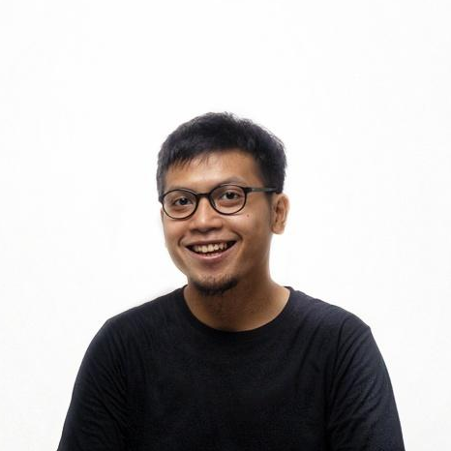
About Me
Works
株式会社FastLabel (~present)
株式会社Inbound Technology
Zero One Group
PT. WISH
Educations
Dongseo University
Politeknik Elektronika Negeri Surabaya
Salahuddin Muhammad Iqbal
@ivokun

Slide 3
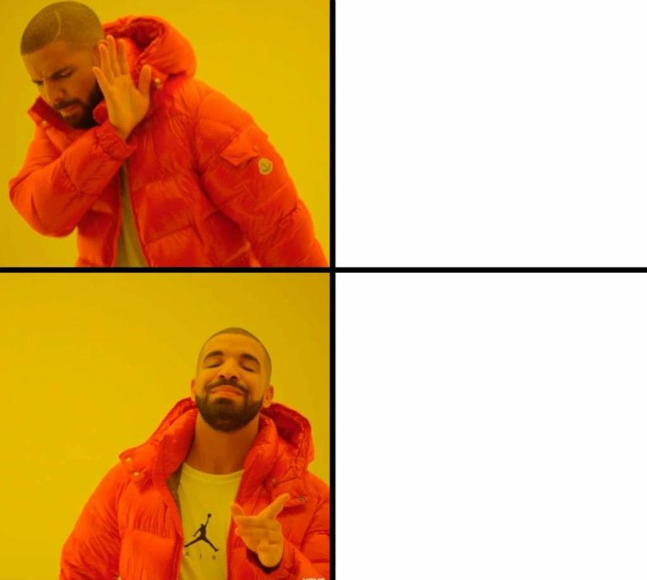
What is NLP?
Neuro Linguistic Programming
Natural Language Processing

Slide 4
What is NLP?
Artificial Intelligence
Natural Language Processing
Natural Language Understanding
Question and Answering
Sentiment Analysis
Named Entity Recognition
…
Natural Language Generation
Machine Translation
Text Summarization
Chatbot
…

Slide 5
What is NLP?
Input
Output
Human Voices
Books
Tweets (Xes?)
News
English
Questions
…
Human Voices
Summarized
Sentiments
Sentiments
Indonesian
Answers
…
Processing

Slide 6





What is NLP?

Slide 7
How it works?
Input: text
Ibu budi pergi ke pasar
[“Ibu”, “Budi”, “pergi”, “ke”, “pasar”]
Tokenization
[“I”, “bu”, “ĠBud”, “i”, “Ġper”, “gi”, “Ġke”, “Ġpas”, “ar”]
Token Embedding
“Ibu”
“Budi”
“pasar”
Decoding: text

Slide 8
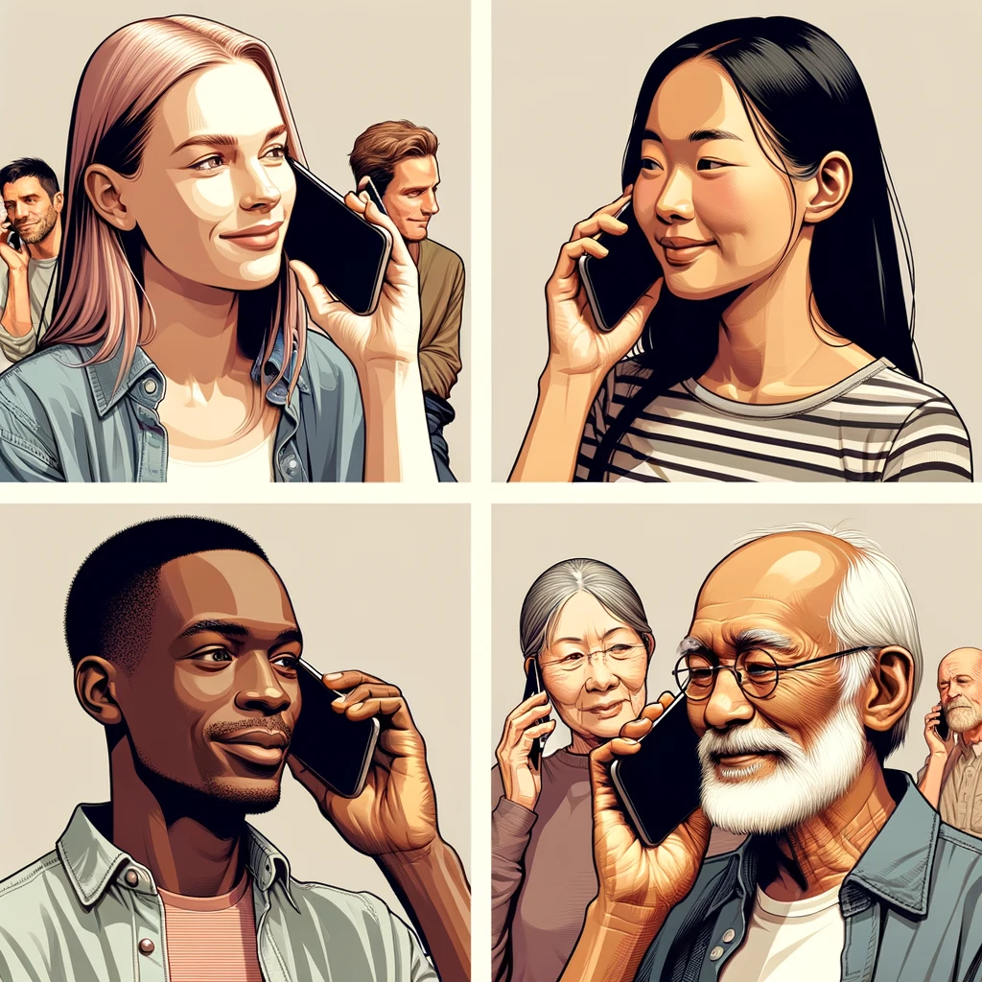
How it works?
Input: voice
Hey Siri, play oppa gangnam style
speech2text
NER
Hey Siri, play oppa gangnam style
Actions

Slide 9
The Process
Input
Normalization
Stop Words Removal
Tokenization
Embedding
Model
Output

Slide 10
The Process
Input
Ibu Budi pergi ke pasar
<p>Ibu Budi pergi ke <strong>pasar</strong></p>
Ibu Budi pergi ke pasar🔥
Ibu Budi prgi ke psr
IBU BUDI PERGI KE PASAR
Ibu Budi pergi k3 pasar

Slide 11
The Process
Normalization
Case normalization
Ibu Budi pergi ke pasar
<p>Ibu Budi pergi ke <strong>pasar</strong></p>
Tags removal
Emoji Removal
Ibu Budi pergi ke pasar🔥
Colloquial Language Removal
Ibu Budi prgi ke psr
Case normalization
IBU BUDI PERGI KE PASAR
Remove Non-Standard Characters
Ibu Budi pergi k3 pasar

Slide 12
The Process
Stop Words Removal
🇬🇧 'have', '’ll', 'up', 'afterwards', 'from' …
🇮🇩 'dirinya', 'jauh', 'cara', 'diminta', 'saling', …
🇬🇧 326 words
🇮🇩 757 words
Before | After
Ibu Budi pergi ke pasar | Budi pergi pasar

Slide 13
The Process
Tokenization
Word Tokenization
["Ibu", "Budi", "pergi", "ke", "pasar"]
Subword Tokenization
["Ibu", "Budi", "per", "##gi", "ke", "pasar"]
Character Tokenization
["I", "b", "u", " ", "B", …]

Slide 14
The Process
Tokenization
Example: Word Tokenization
Corpus
Normalization
Split texts into words
Vocabulary
Map tokens to Vocab

Slide 15
The Process
Tokenization
Corpus
"Ibu Budi pergi ke pasar pagi ini. Di pasar, Ibu Budi membeli buah-buahan segar seperti apel dan pisang. Setelah itu, Ibu Budi bertemu dengan Pak Dodi yang juga sedang berbelanja."
Vocabulary
{"Ibu", "Budi", "pergi", "ke", "pasar", "pagi", "ini", "Di", "membeli", "buah-buahan", "segar", "seperti", "apel", "dan", "pisang", "Setelah", "itu", "bertemu", "dengan", "Pak", "Dodi", "yang", "juga", "sedang", "berbelanja", ...}
Map Tokens
[“Ibu”, “Budi”, “pergi”, “ke”, “pasar”] -> [0, 1, 2, 3, 4]

Slide 16
Fun Fact
🇬🇧 The Oxford English Dictionary >600,000 words.
🇮🇩 Kamus Besar Bahasa Indonesia >100,000 words
How to tokenize non-space texts?
ブディの母親は市場へ行く
布迪的妈妈去了市场
ذهبت والدة بودي إلى السوق
বুদির মা বাজারে গেছে
Budi의 어머니는 시장에 갔다

Slide 17
Resources
https://web.stanford.edu/class/cs224n
https://spacy.io/
https://www.nltk.org/
https://huggingface.co/learn/nlp-course/chapter6/1?fw=pt

